Slide 1
Teacher day card
By DMN

Slide 2
Sản phẩm
https://capriozero.github.io/

Slide 3
Có 4 thành phần quan trọng trong thiết kế
Loader
Falling flowers
Fold out card
Image map

Slide 4
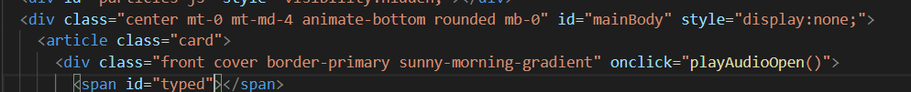
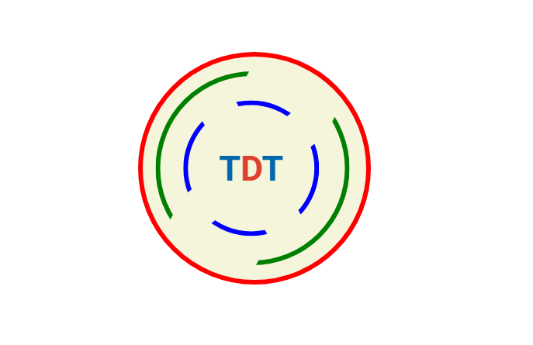
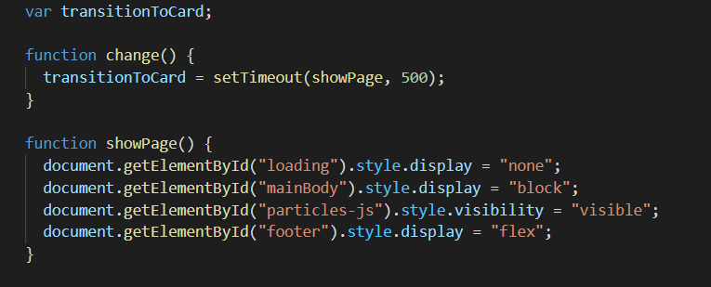
Loader

Slide 5
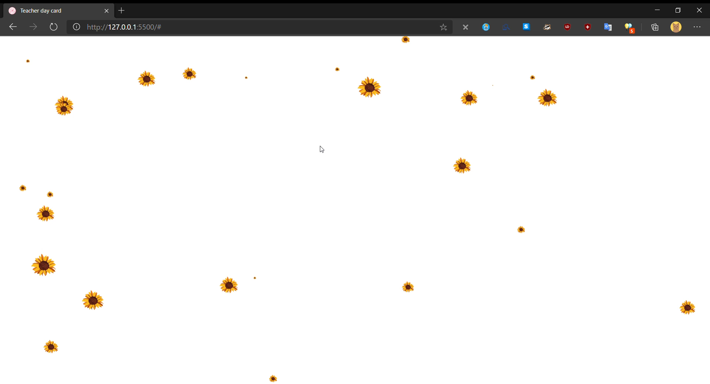
Falling petal

Slide 6

https://vincentgarreau.com/particles.js/

Slide 7


Fold out card

Slide 8

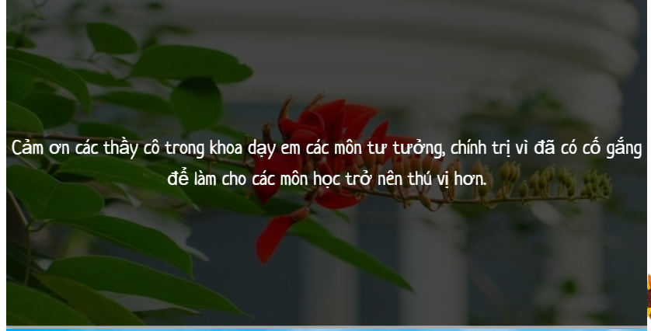

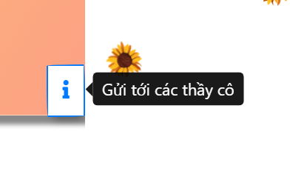
Mdbootstrap (https://mdbootstrap.com/)

Slide 9
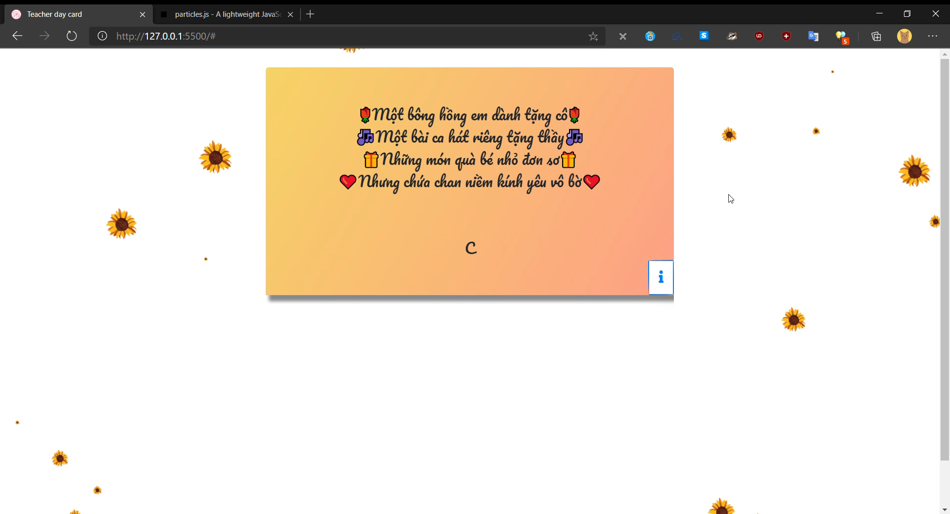
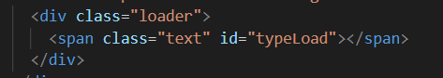
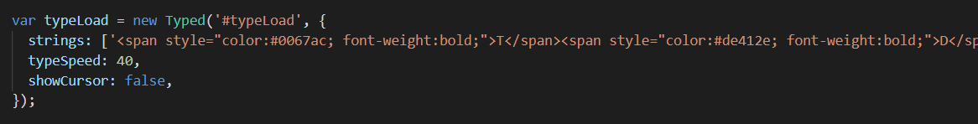
Type writer effect with Typed-js
https://mattboldt.com/demos/typed-js/

Slide 10
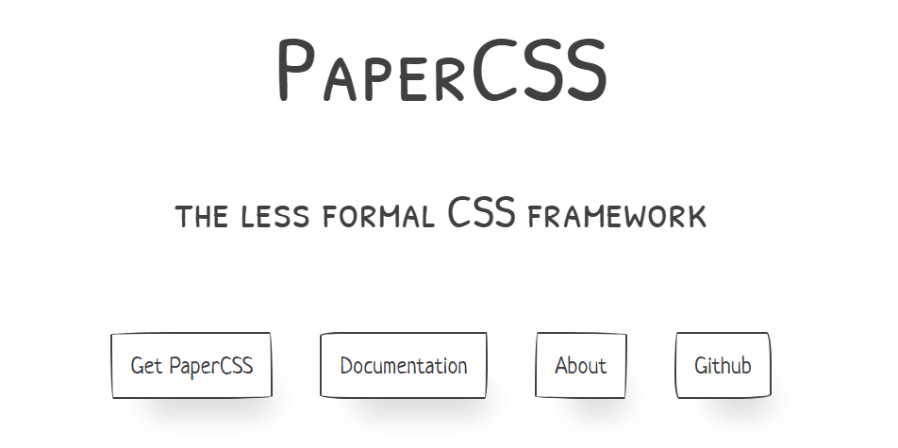

Paper css (https://www.getpapercss.com/)

Slide 11

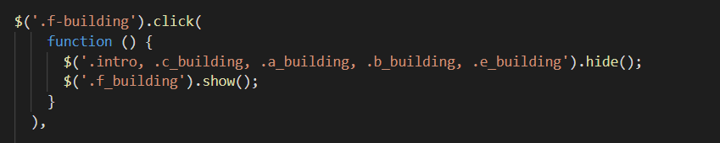
Map tag in html
Create with: https://www.image-map.net/

Slide 12
Cảm ơn quý thầy cô và các bạn đã lắng nghe

